Slide 1
Heart Disease Predication with Supervised Machine Learning Algorithm
Hua Mo
Data Science Career Track Capstone Project #2

Slide 2


The Problem
Heart disease is the leading cause of death for men and women in the United States
How to predict a heart disease is a challenge
Many symptoms associate with the heart disease
Can we predict the heart disease by machine learning Algorithm?

Slide 3
Who cares about?
Health care provider
Hospital
Pharmaceutical
Our Family

Slide 4
Potential Symptoms
age
sex
chest pain type (cp, 4 values)
resting blood pressure (trestbps)
serum cholesterol in mg/dl (chol)
fasting blood sugar > 120 mg/dl (fbs)
resting electrocardiographic results (restecg, 3 values)
maximum heart rate achieved (thalach)
exercise induced angina (exnag)
ST depression induced by exercise relative to rest (oldpeak)
the slope of the peak exercise ST segment (slope)
number of major vessels (0-3) colored by fluoroscopy (ca)
#thal (unknown, 2 values)

Slide 5

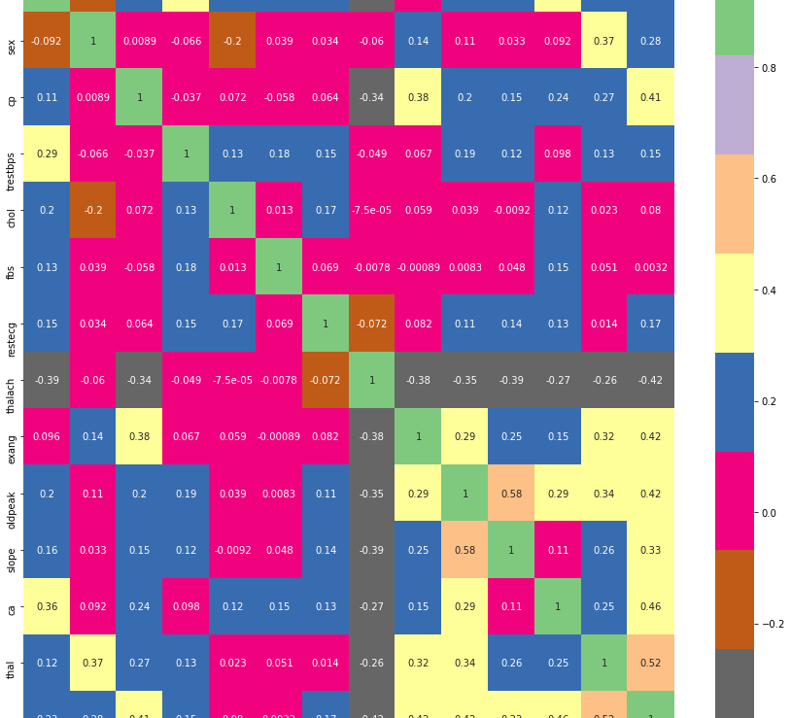



Heatmap
Positive response
Negative response
Insignificant response

Slide 6
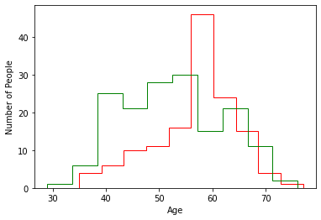
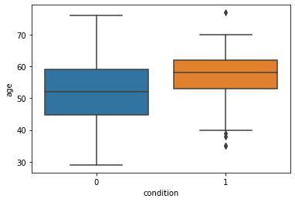
Age Distribution
Heart Disease People mostly in 60

Slide 7
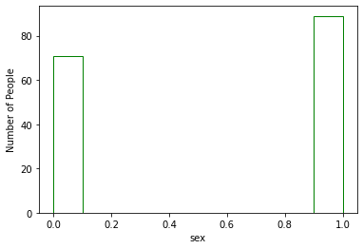
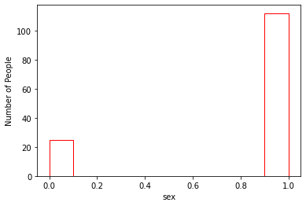
Sex Distribution
More Male in the Heart Disease

Slide 8
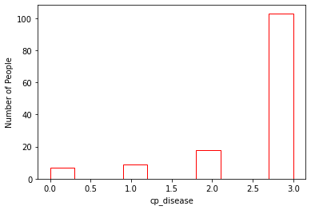
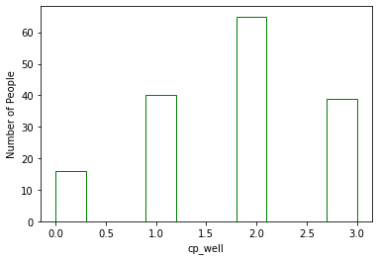
Chest Pain (cp)
Heat disease have more level 4 chest pain

Slide 9
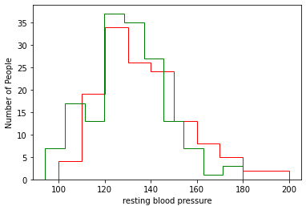
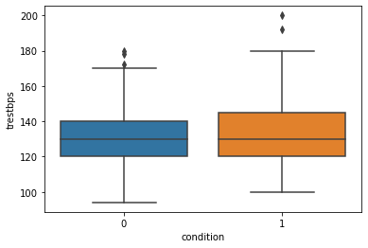
Resting Blood Pressure (Trestbps)
The heart disease people tends to have more people in resting blood pressure

Slide 10
Resting Blood Pressure (Trestbps)
The heart disease people tends to have more people in resting blood pressure

Slide 11
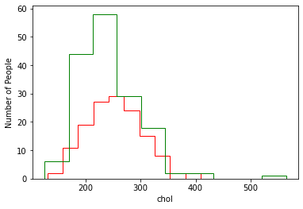
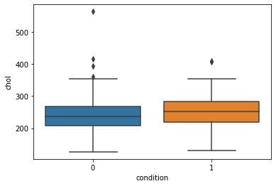
Serum Cholestroel (chol)
Cholesterol did not have significant difference

Slide 12
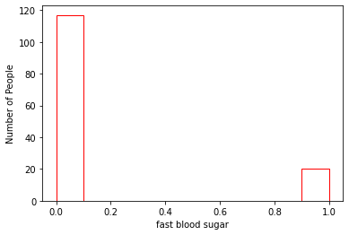
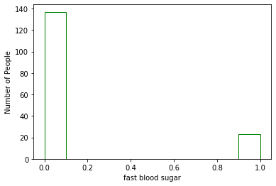
Fast Blood Sugar > 120 mg /dl (Fbs)
There is no significant difference between fast blood sugar

Slide 13
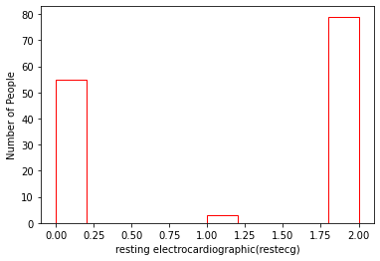
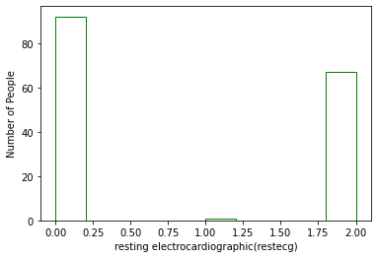
Resting Electrocardiographic (Restecg
There is not a significant difference in resting electrocardiographic, except the small distribution

Slide 14
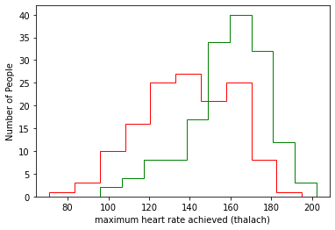
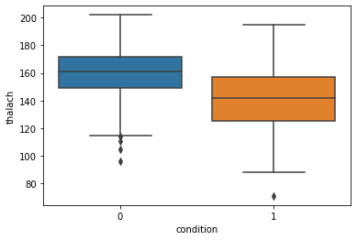
Maximum Heart Rate (Thalach)
The maximum heart rate was lower for the heart disease people

Slide 15
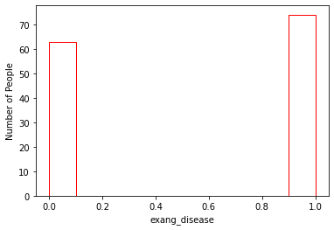
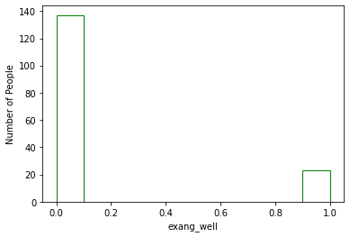
Exercise Induced Angina (Exnag)
The exercise induced angina shifted higher for the heart disease people

Slide 16
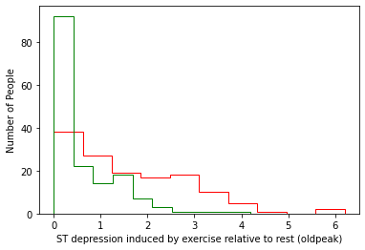
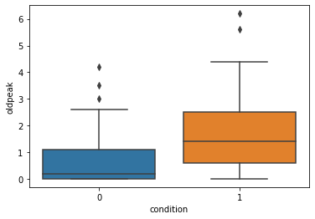
ST Depression Induced by Exercise Relative to Rest (Oldpeak)
ST depression induced by exercise relative to rest shifted to higher for the heart disease people

Slide 17
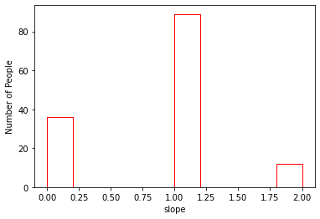
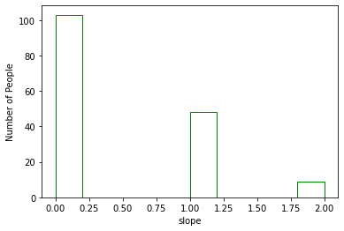
The Slope of the Peak Exercise ST Segment (Slope)
The slope of the peak exercise ST segment shift to flat for heart disease people

Slide 18
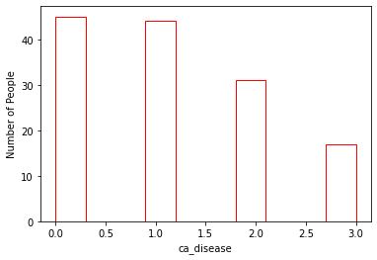
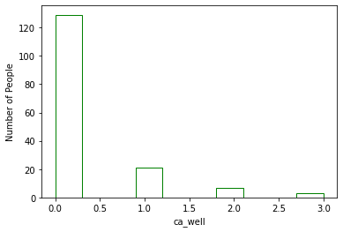
Number of Major Vessels Colored by Fluoroscopy (ca)
More number of vessels can be colored for the heart disease people

Slide 19
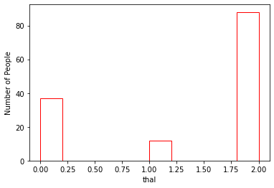
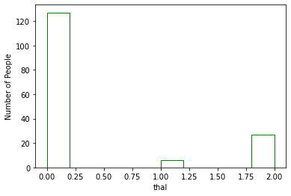
Unknown Symptom (Thal)
More defects were found for the heart disease people

Slide 20
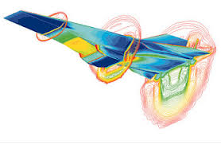
Prediction Model
Logistic Regression
Decision Tree
Random Forest

Slide 21
Model Performance
Model | Accuracy | F-1 Score
Logistic Regression | 0.867 | 0.867
Decision Tree | 0.833 | 0.833
Random Forest | 0.833 | 0.833

Slide 22
Feature of Importance
Logistic Regression: ca > thal > cp > sex > slope >
exang > trestbps > fbs> oldpeak
> thalach > chol > restecg > age
Decision Tree: thal > ca > cp > age > exang > oldpeak
Random Forest: thal > thalach > cp > ca > age > chol >
oldpeak > tresbps > exang > sex
> slope > restecg > fbs

Slide 23
Conclusion
There are no difference between these models
The importance of feature will depend on the model
Recommend Random Forest

